Slide 1

Your Smart Automatic Humidifier
Andrew Sherwin - Woojin Kim - Jalen Chen
TA: Surya Vasanth
Professor: Dr. Jonathon Schuh
Notes:
Every

Slide 2
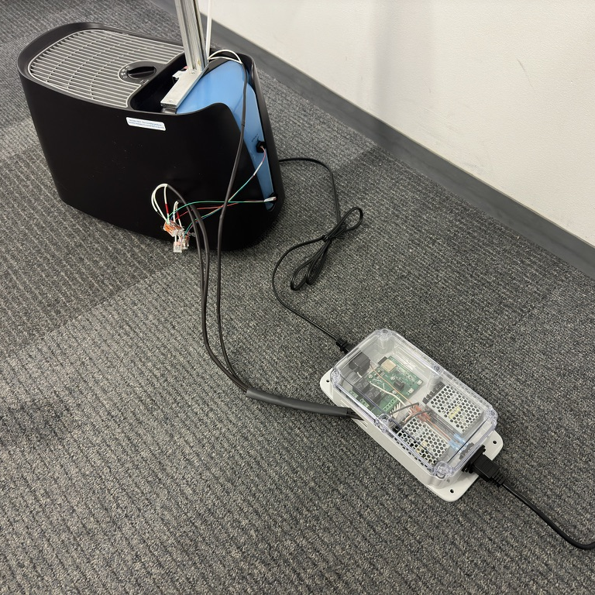
Agenda
Problem & Solution
Visual Aid
High Level Requirements
Block Diagram
Webserver and Algorithm
RV Table
Project Achievements
Future Plans
Notes:
Andrew

Slide 3


Problem
Environmental Protection Agency highly suggests 30-50% humidity indoors
Chemicals, gasses, pollen, mold, and other particles are reduced
Most cheap humidifiers are bad for the user's health
Warm mist – cause nasal passages to swell
Ultrasonic – displaces minerals and bacteria
Manual humidifiers can over/under humidity
Humidifiers on market need manual water refilling
Notes:
Andrew

Slide 4
Solution
Cool mist humidifier
Good for health
Evaporates water off filter
Automatic on/off humidifier based on humidity
Remote humidity sensing via 3 sensors
Automatic water refill via water valve with water level sensing
Notes:
Andrew

Slide 5
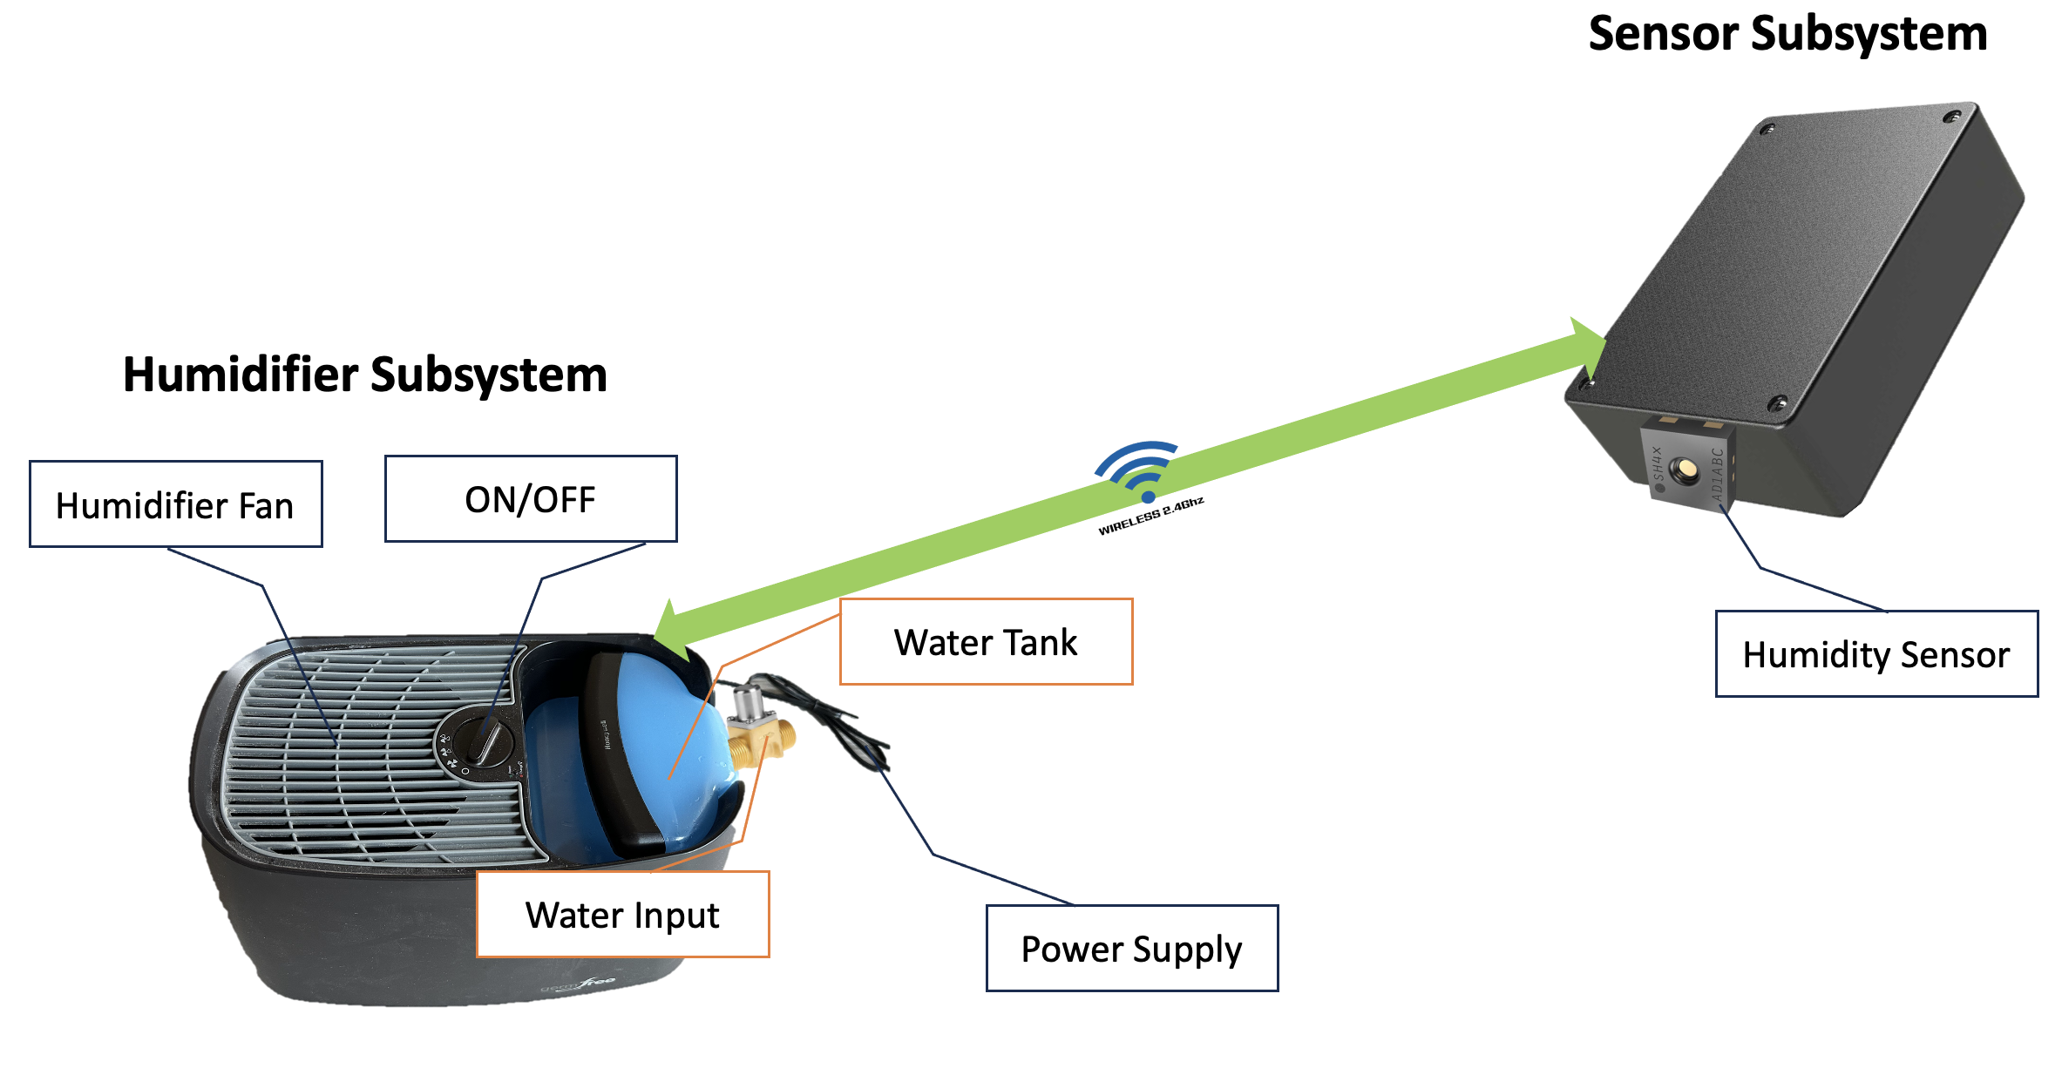
Visual Aid
Notes:
Andrew

Slide 6
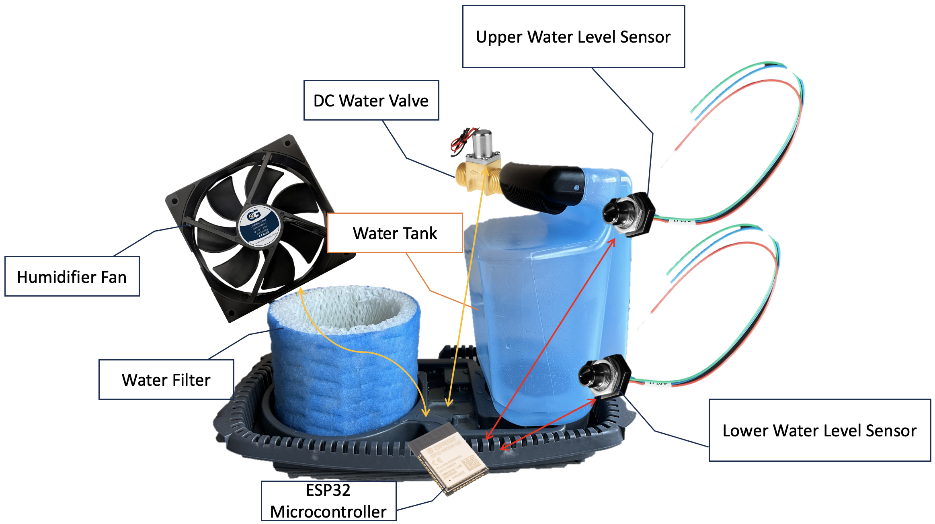
Visual Aid - Component
Notes:
Andrew
Two sensors locations
Water valve and Fan
-> all talks to ESP32

Slide 7

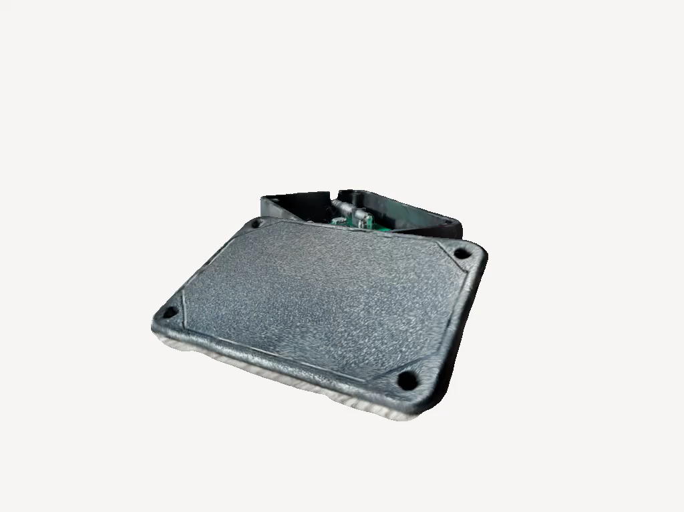
High Level 1
Humidifier's ESP32 communication with three different sensors via 2.4GHz Wi-Fi
Average humidity data from three sensors
Create temperature dependent humidity calculation algorithm
Notes:
Jalen
Talk about why we chose 2.4GHz wifi over bluetooth (range and wall penetration)

Slide 8
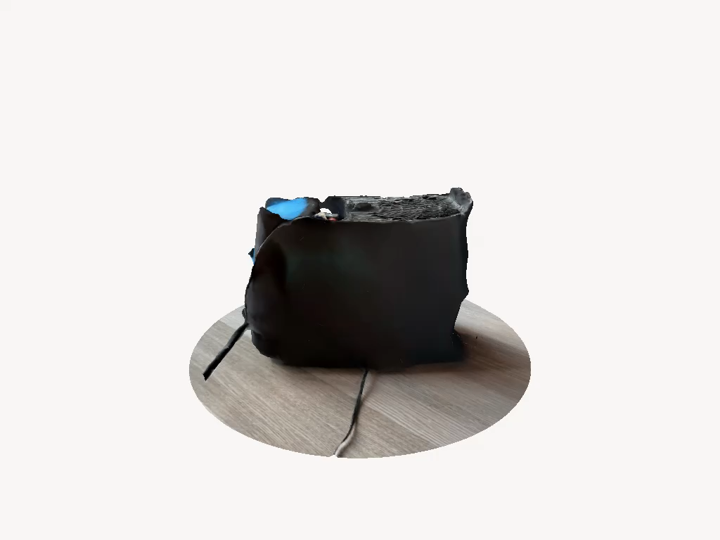
High Level 2
Open/close valve to refill the water tank
Two water level sensors GPIO input to ESP32
Max capacity of the water tank: 4.16 liters
Filter absorbs around 150 milliliters ± 5 milliliters
Evaporation rate approximately 173 milliliters per hour (in 40% humidity room)
Notes:
Jalen
173 milliliter is from (max capacity)/(time for tank to empty) = 4160/24-hour = 173.33 milliliter
Filter absorbing 150 milliliter is from wringing out filter and measuring the volume

Slide 9
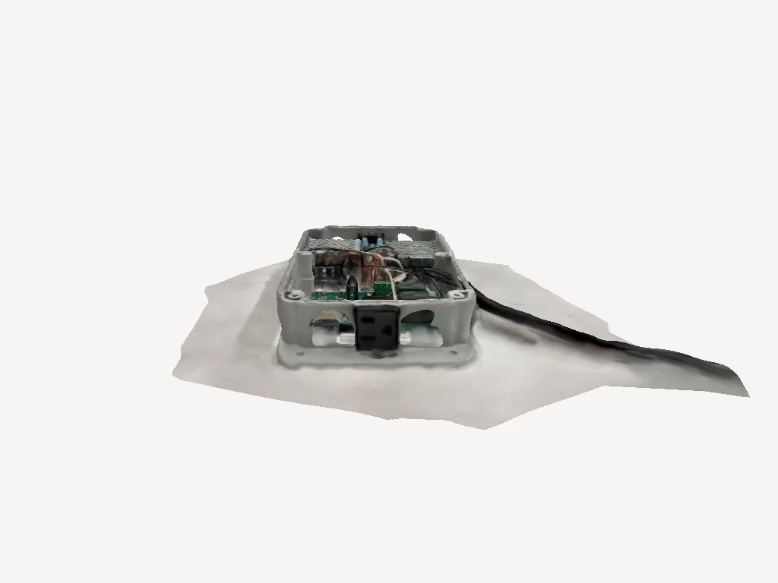
High Level 3
On/off fan based on pre-configured ideal humidity range, 35% and 50% humidity, based on an algorithm averaging the readings from 3 sensors
Actuate relay with LED output for ON signal
Theoretical estimation of 44ns response time to on/off the humidifier’s fan (w/o runtime)
High voltage (120V AC) components does not interfere with low voltage components (< 12V DC)
Notes:
Woojin
44ns from: SHT45 -> ESP32 -> wifi of 6m range -> ESP32 -> algorithm -> relay actuation
1 bit of data only
Realistically:
2 bytes of data for humidity, 2 bytes of data for temperature
Data needs to be unpacked by ESP32 (sensor subsystem) and repacked for WiFi transmission -> ESP32 (humidifier) needs to unpack data -> send acknoledgement back -> ESP32 (sensor) unpacks data -> output on console
That is why we got 45,000ns

Slide 10
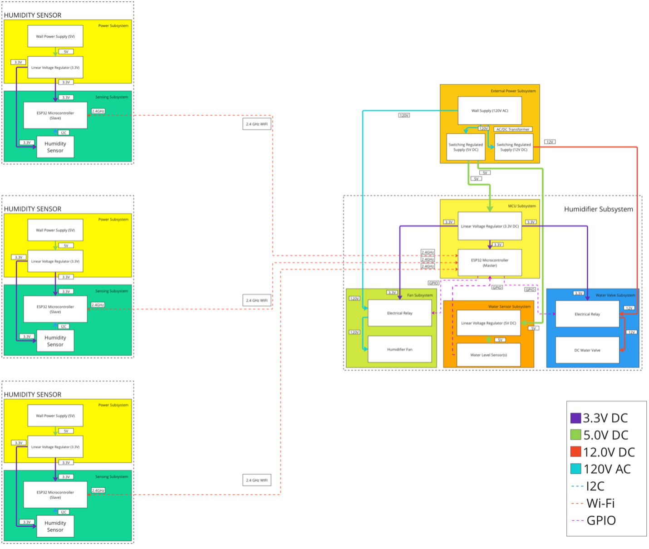
Block Diagram
Notes:
andrew

Slide 11
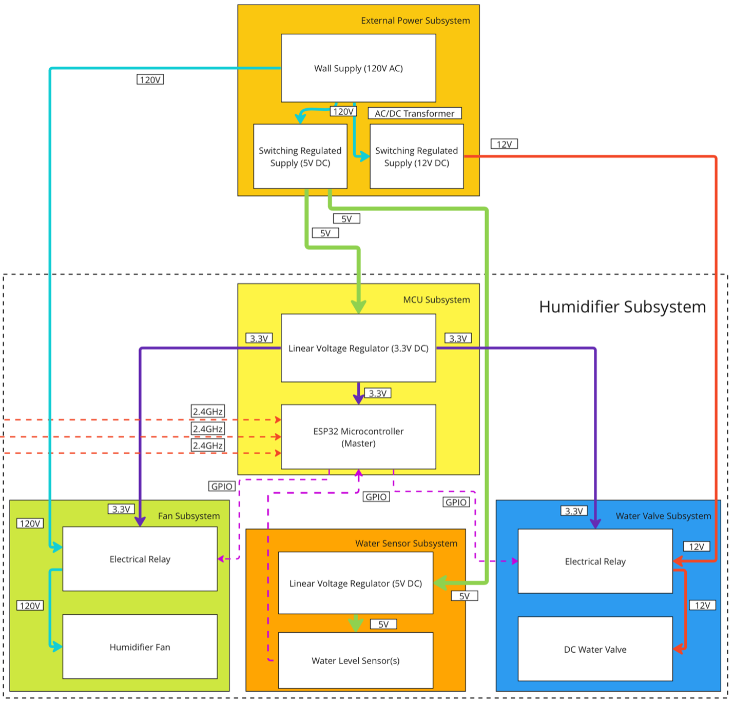
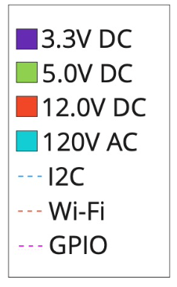
Block Diagram - Humidifier
Notes:
andrew

Slide 12
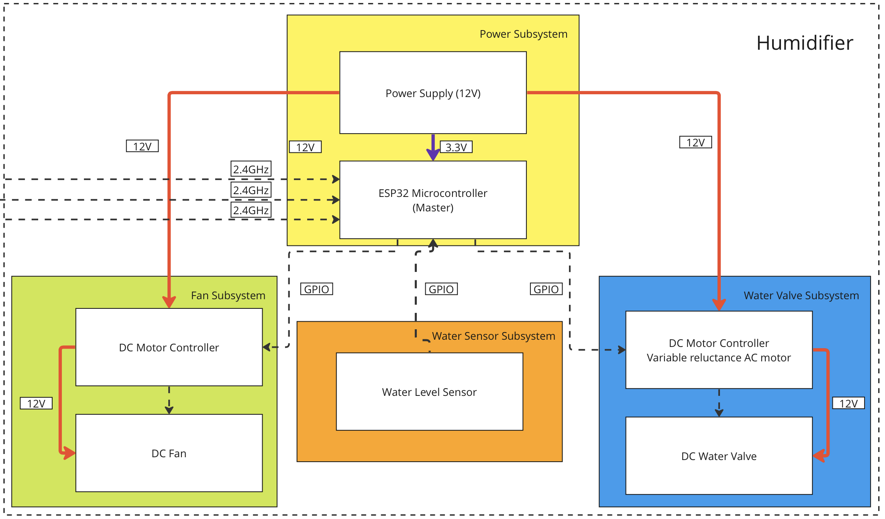
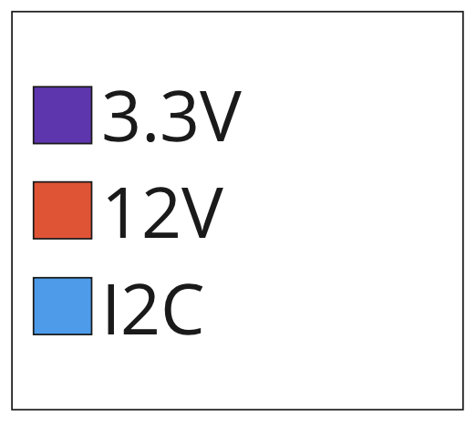
Current vs Original Humidifier Subsystem
Original Block Diagram – Project Proposal
Notes:
Originally have 12V input and utilize DC motor controllers
12V was to be shared between DC fan and water valve, and PCB
Too hot
DC motor controller not needed
Make modular so use relay for fan/humidifier
Water valve no pressure for demo

Slide 13
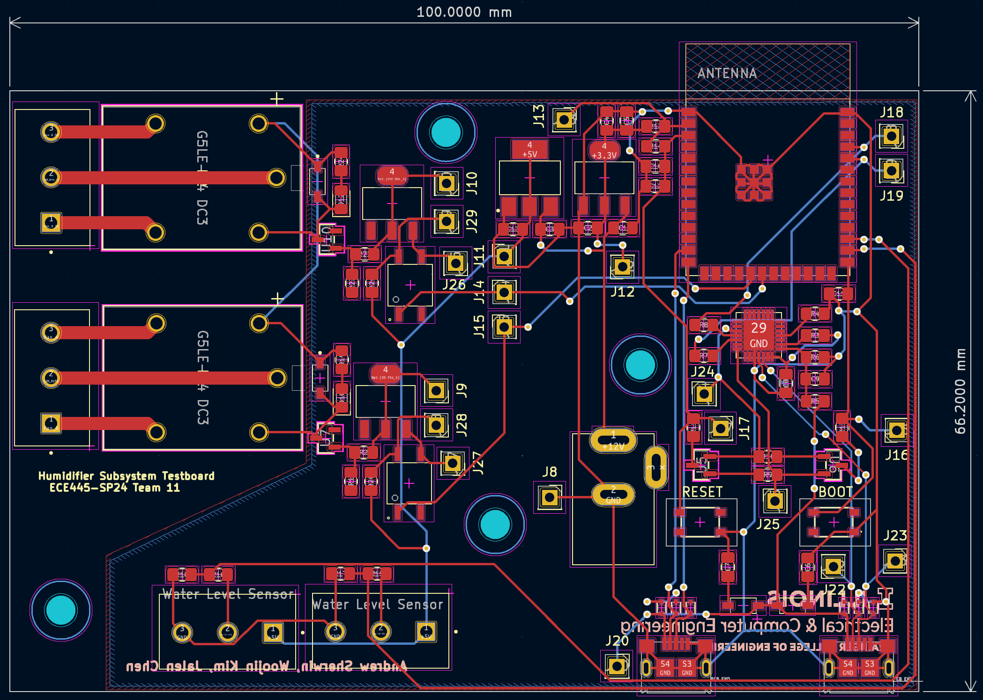
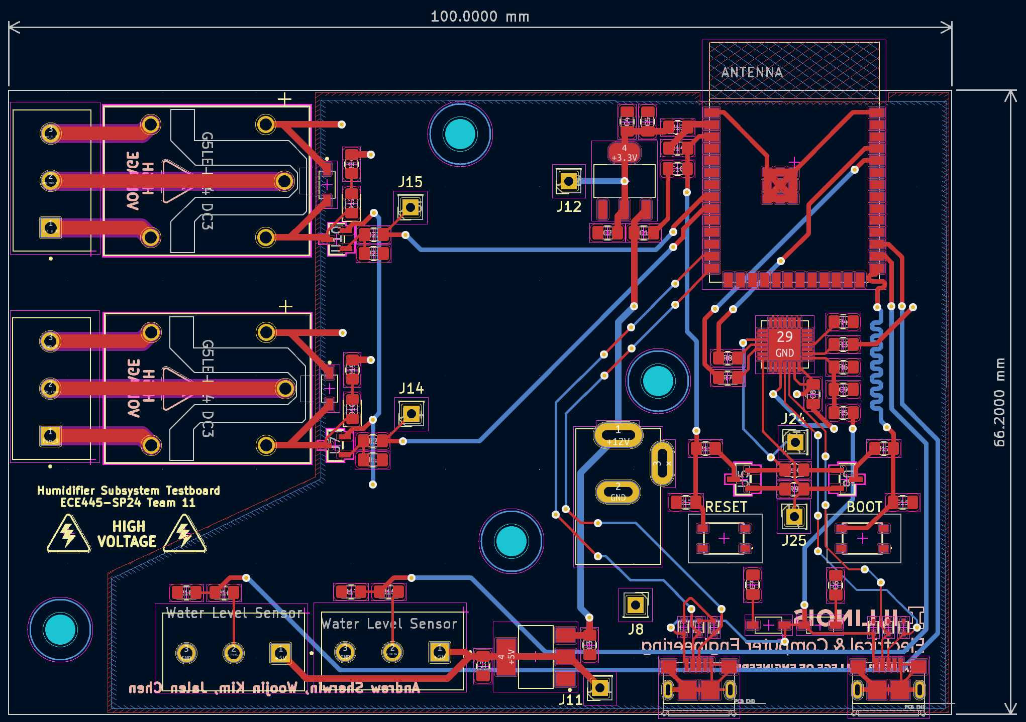
Humidifier Subsystem PCBs
Humidifier PCB Rev0
Humidifier PCB Rev4
Notes:
We keep using rev 0
Has optocoupler
Rev4 has cutout for better isolation
Better isolated components
Warning sign
Rev5 would only have esp32 and no programming components

Slide 14
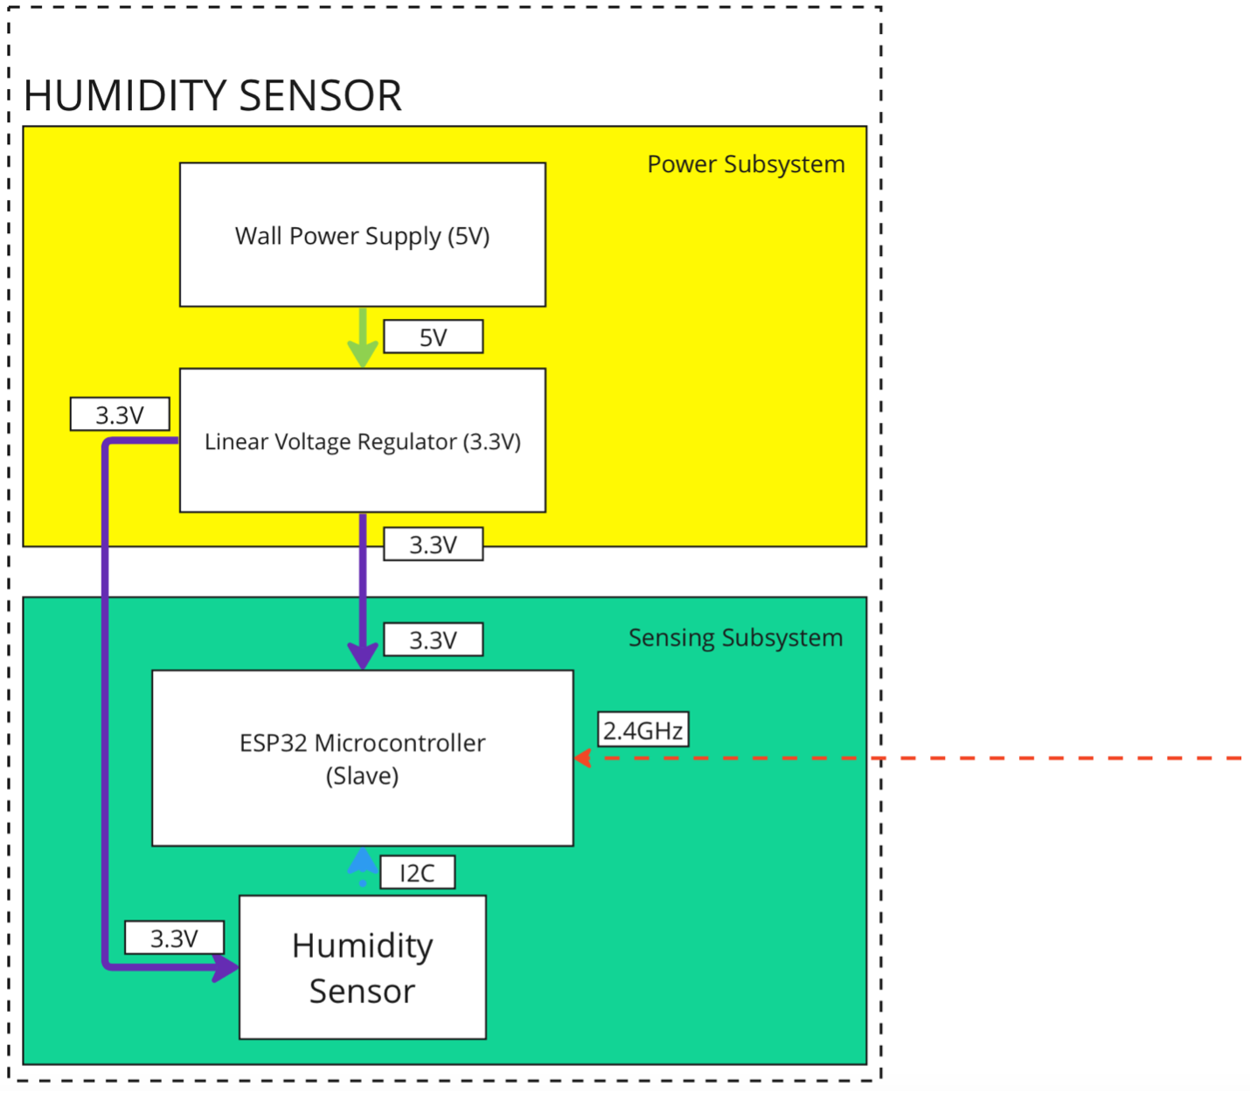
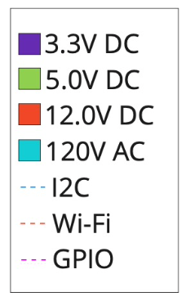
Block Diagram - Sensor
Notes:
Andrew

Slide 15
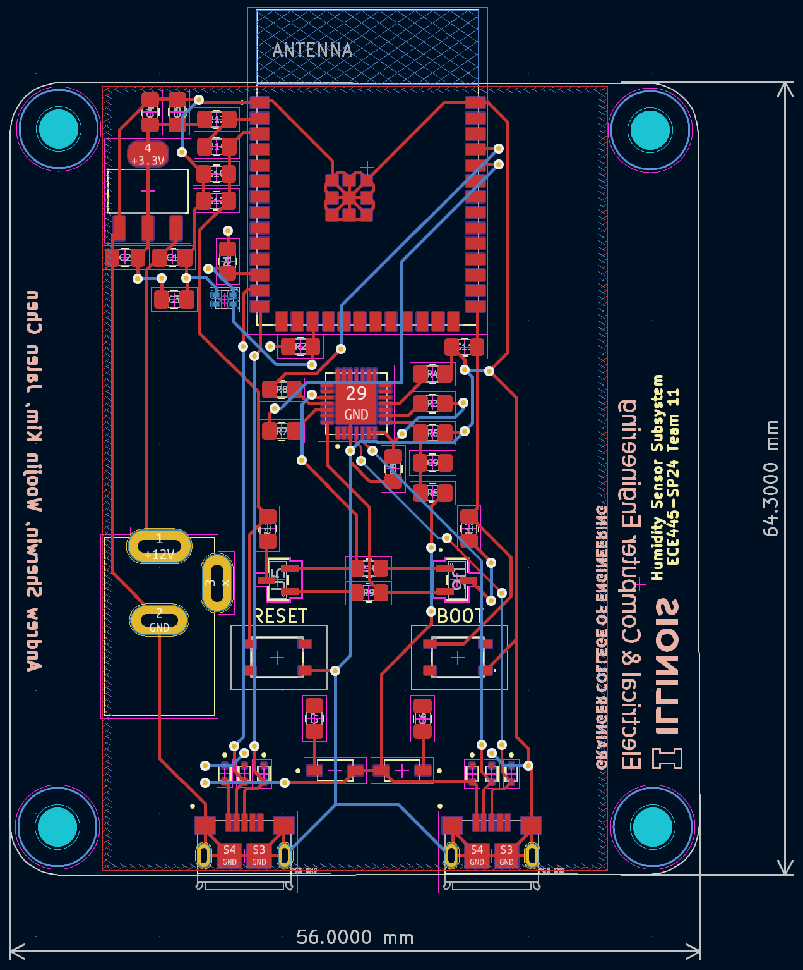
Sensor Subsystem PCBs
Humidifier PCB Rev0
Notes:
Mention about location of sensor
isolated

Slide 16
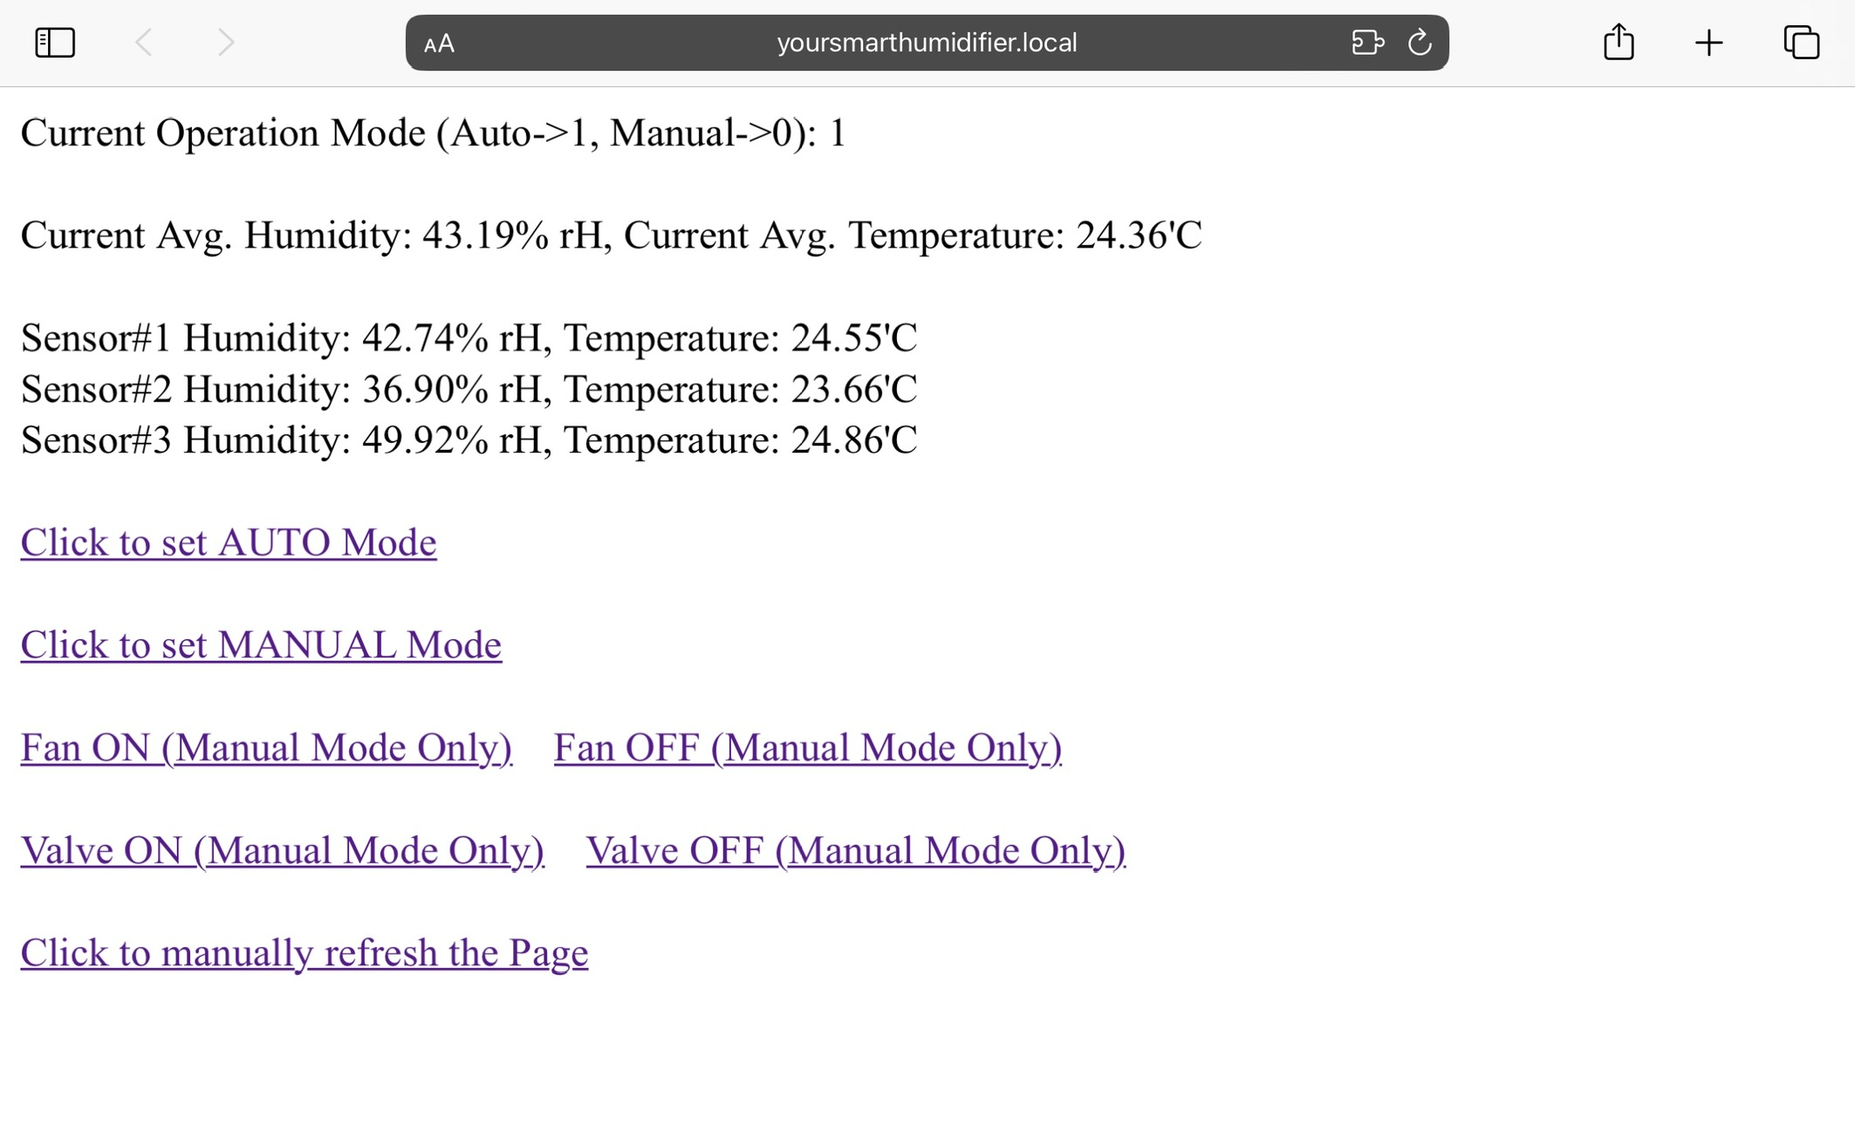
Web Server & Algorithm
WiFi access with mDNS
Auto/Manual Mode
(Fan/Valve off when Auto->Manual)
Signal Loss Detection
Refreshes every 2s
Warmer air can handle more moisture
-> new Humidity target based on average temperature
(if avg. Temp < 20'C -> 35~42.5% Rh)
(if avg. Temp > 22'C -> 42.5~50% Rh)
(else, 35~50% Rh)
Notes:
Woojin

Slide 17
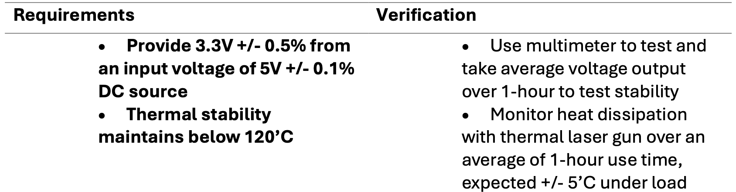
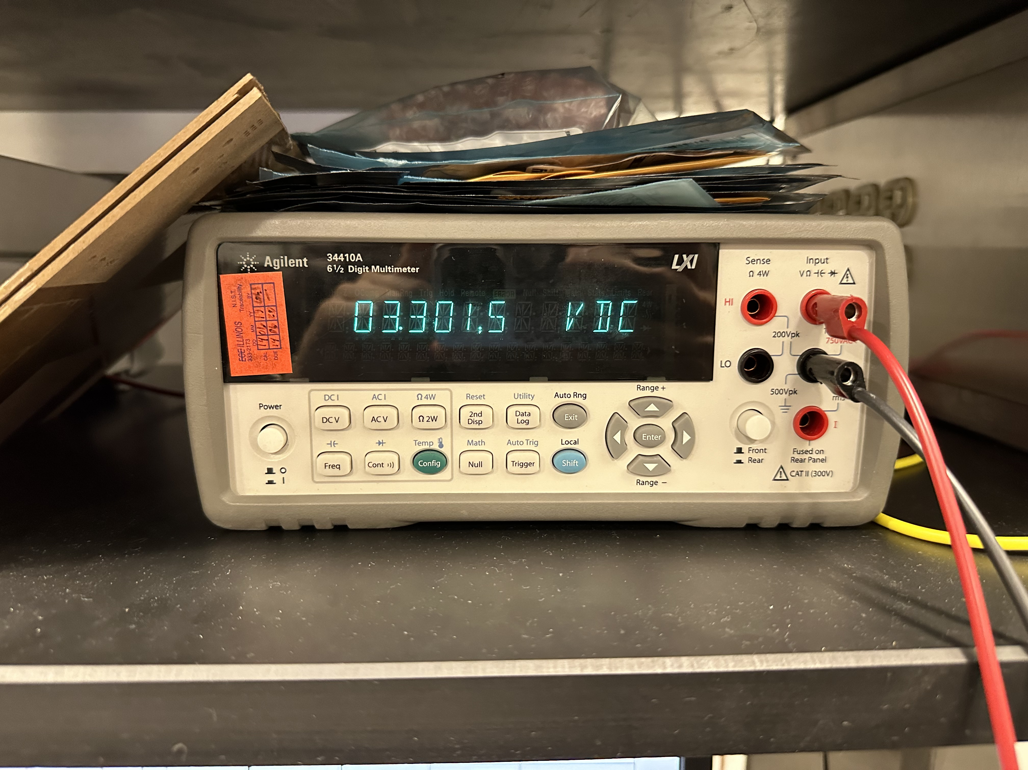
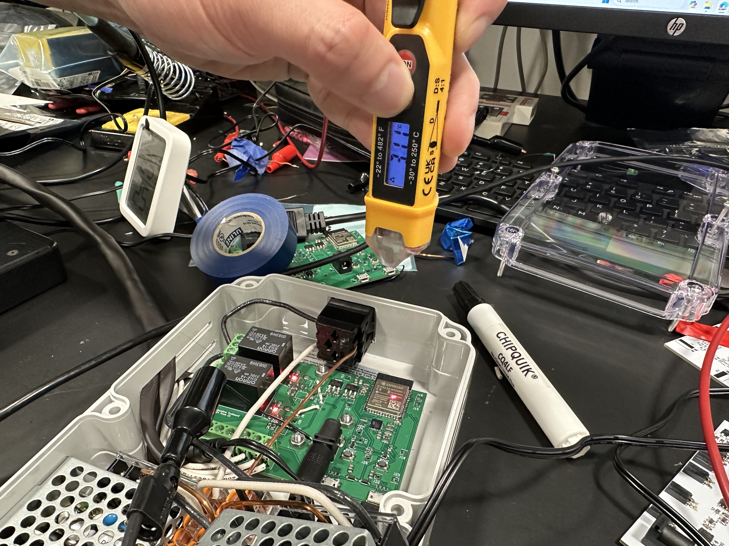
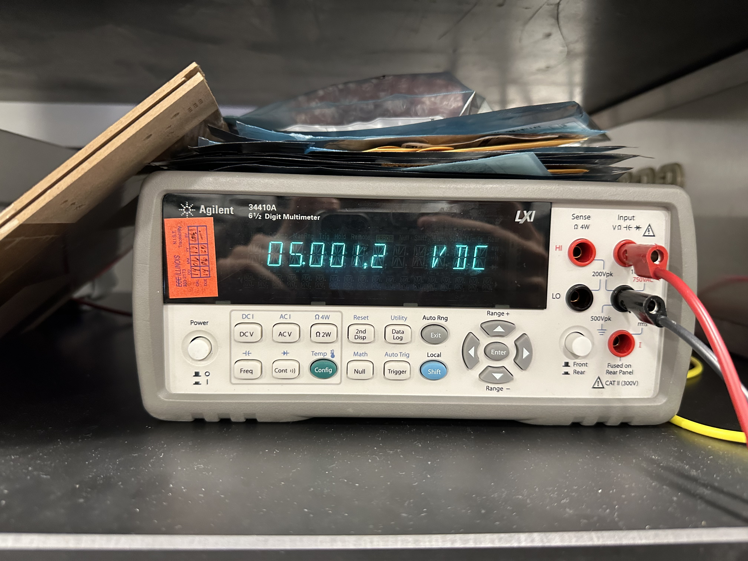
RV Table – Central Humidifier Subsystem (1)
3.3V linear regulator output
Temperature reading with laser
5V linear regulator output
Notes:
jalen

Slide 18
RV Table – Central Humidifier Subsystem (1)
Notes:
Jalen
Talk about voltage readings taken every minute for 1 hour
Very linear readings

Slide 19
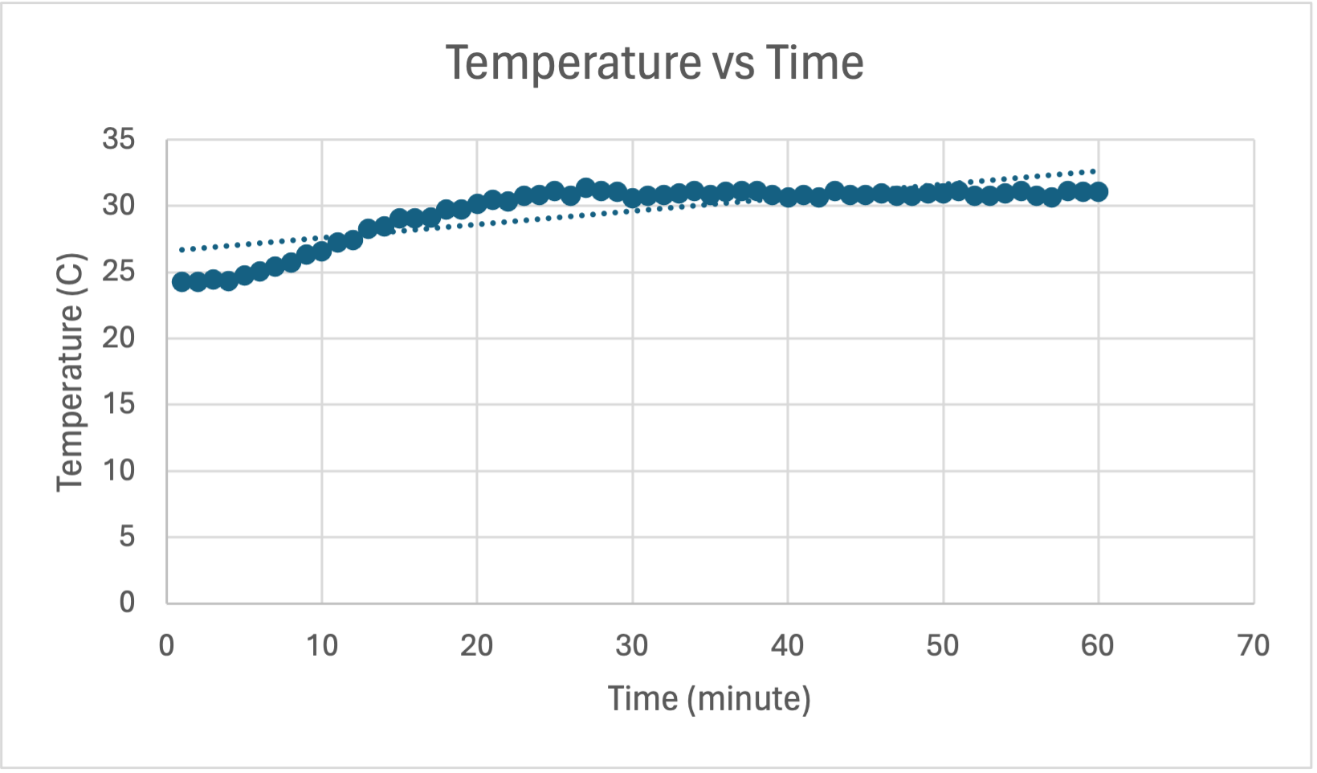
RV Table – Central Humidifier Subsystem (1)
Notes:
Jalen
Talk about how it starts at room temperature, then stabilizes after "warm up"

Slide 20
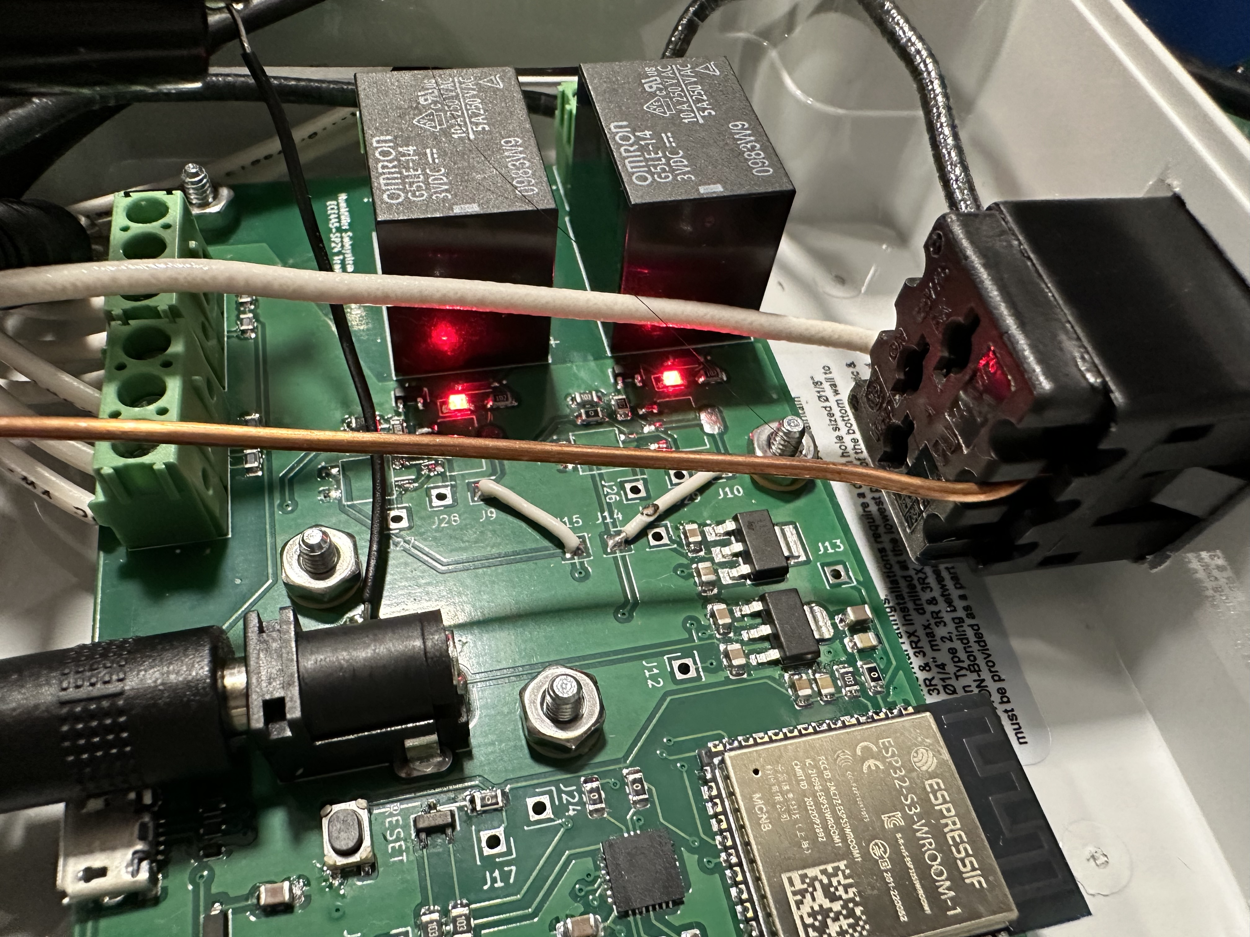
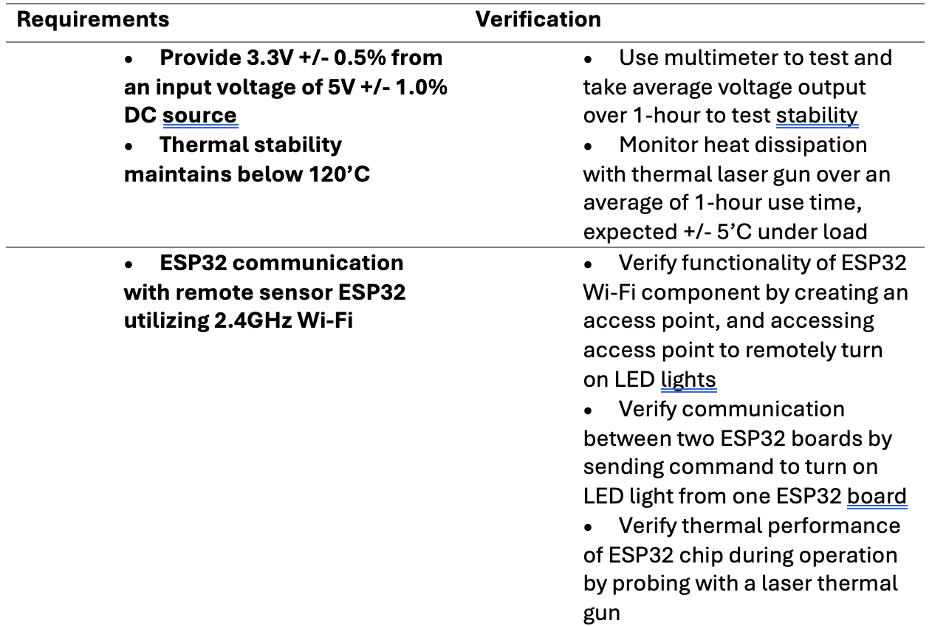
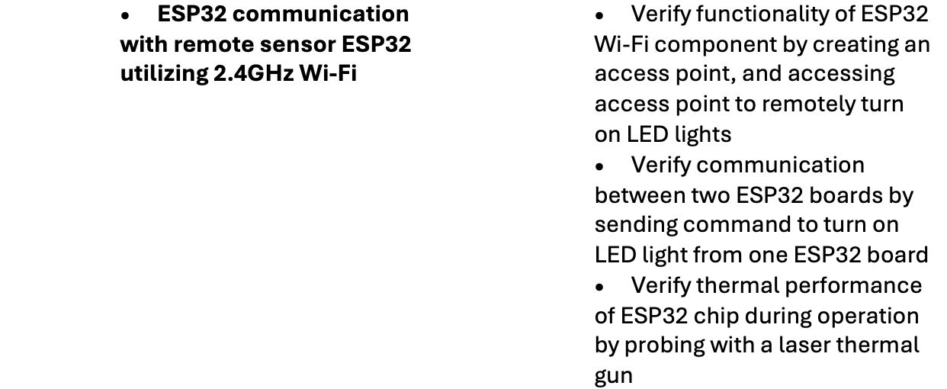
RV Table – Central Humidifier Subsystem (2)
LED light control example
Temperature reading example
Notes:
Jalen maybe andrew
Turn on LED via access point on ESP32 with GPIO signal
Turn on same LED via access point using two ESP32s communicating the GPIO signal to test WiFi

Slide 21
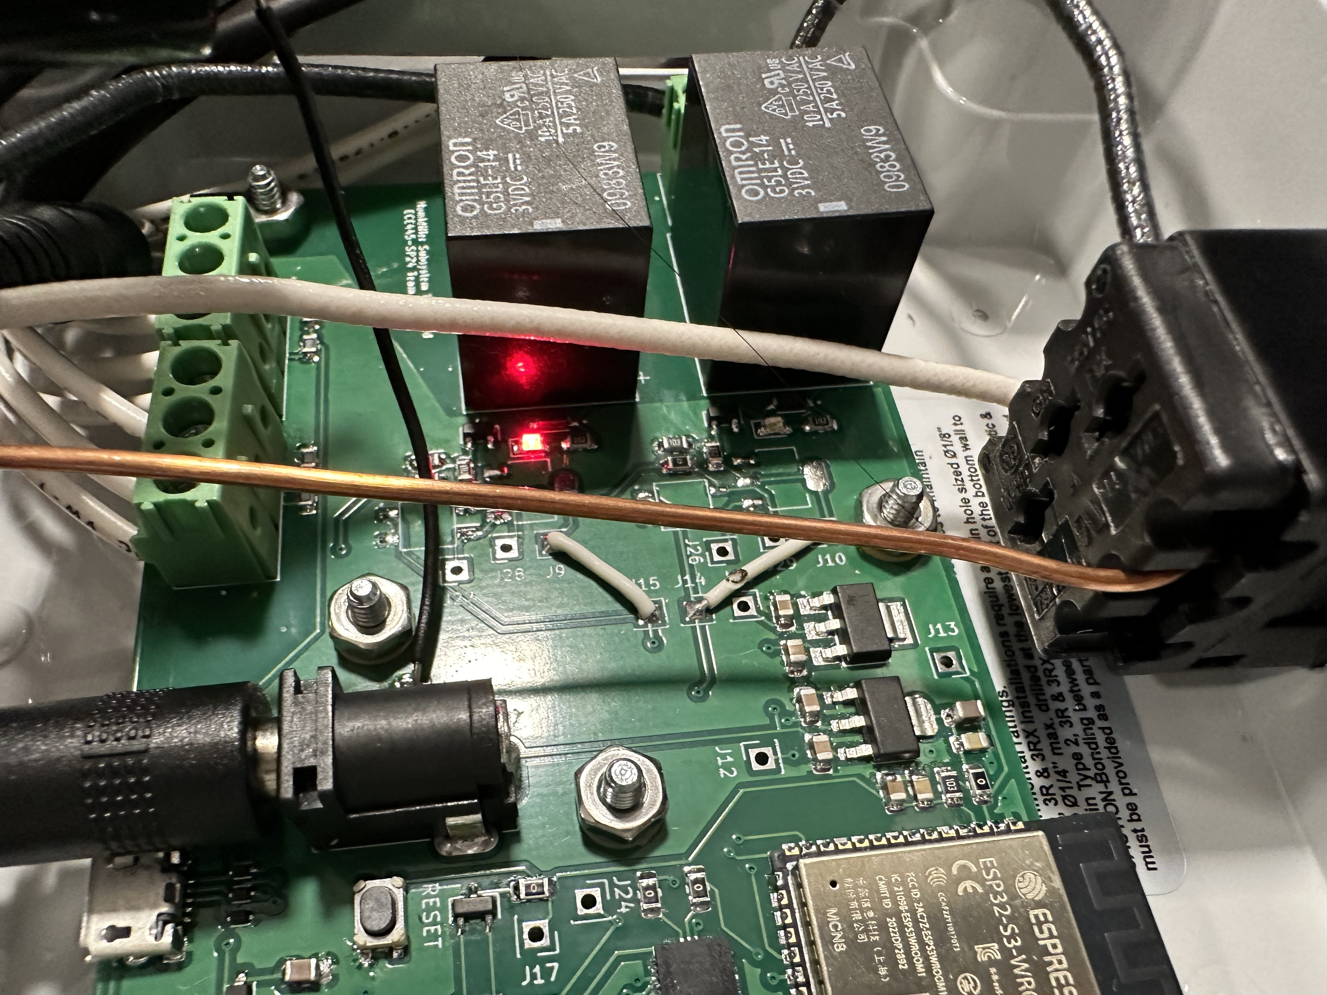
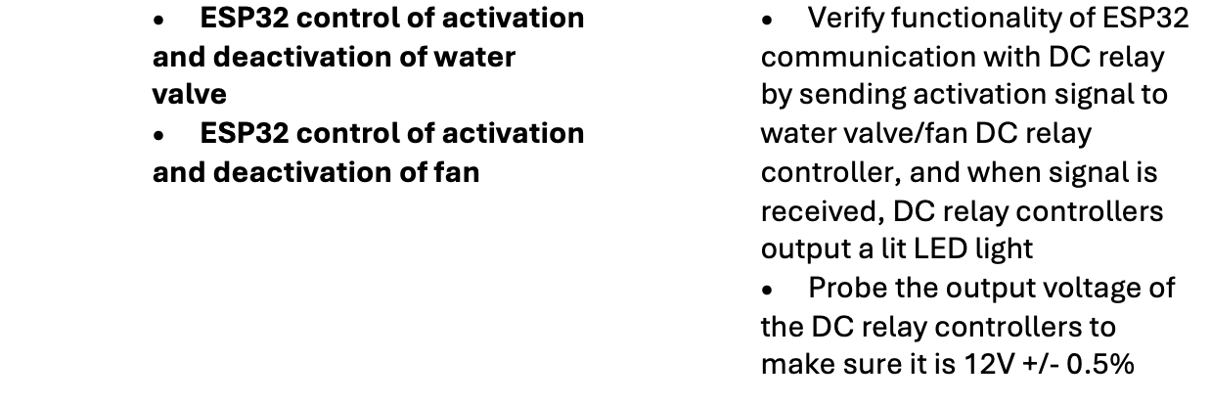
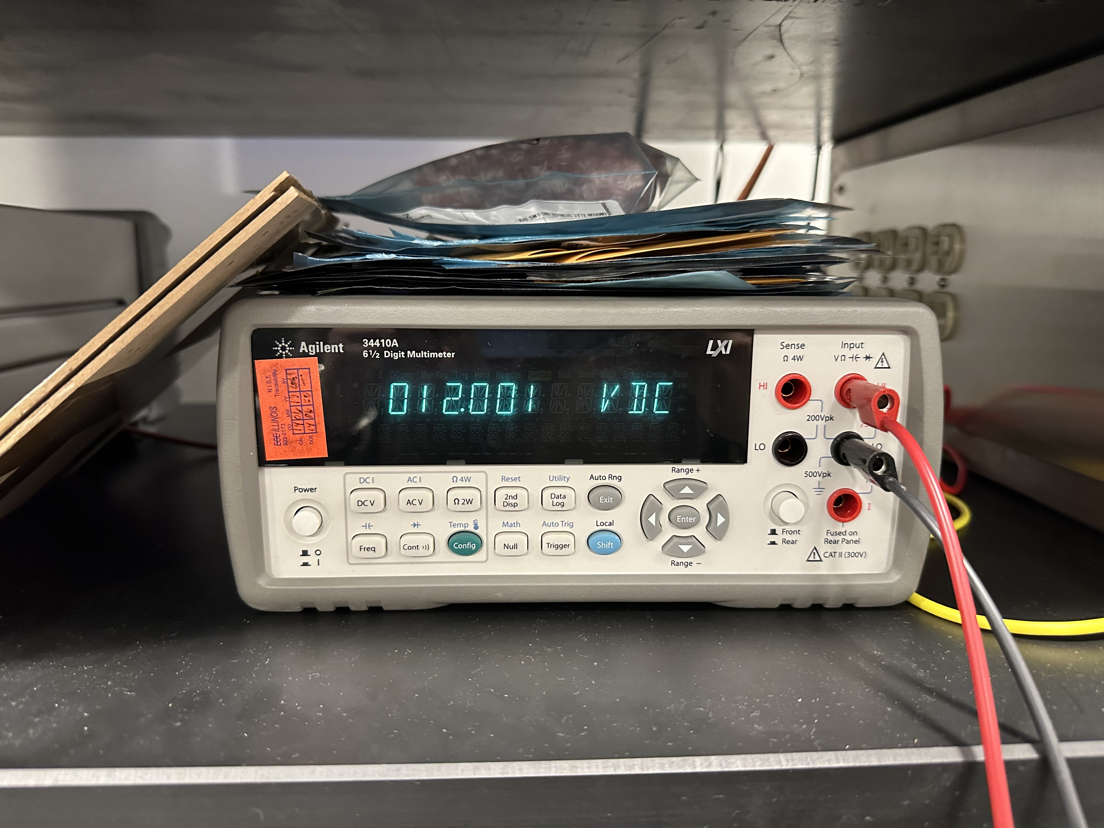
RV Table – Central Humidifier Subsystem (3)
LED light when valve is on
12V output to water valve
Notes:
Jalen, maybe andrew
Relay actuates with GPIO signal
Continuity test relay connectors to make sure relay is actually switching

Slide 22
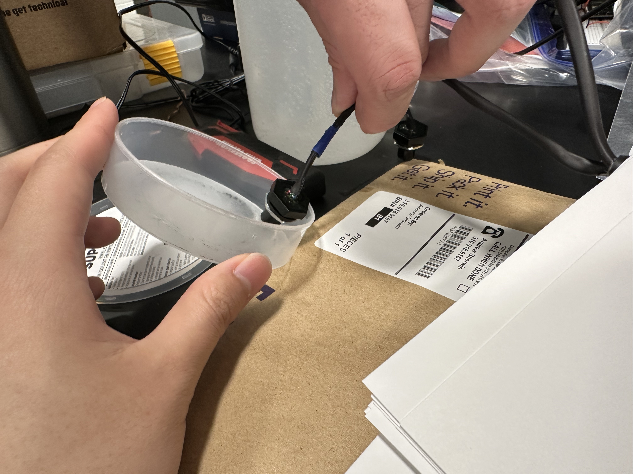
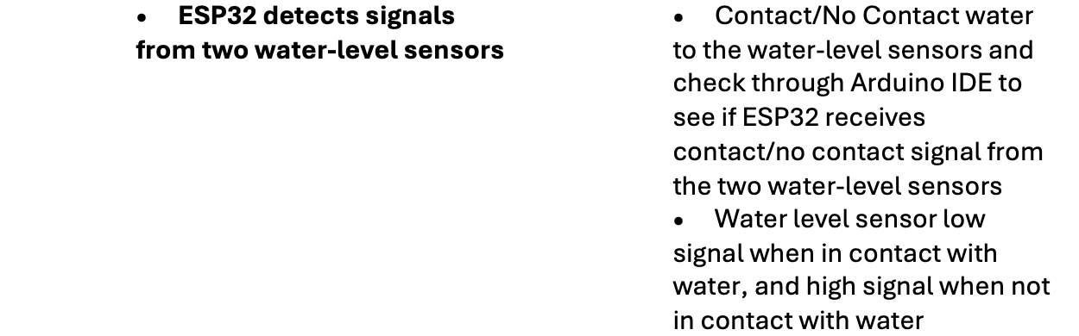
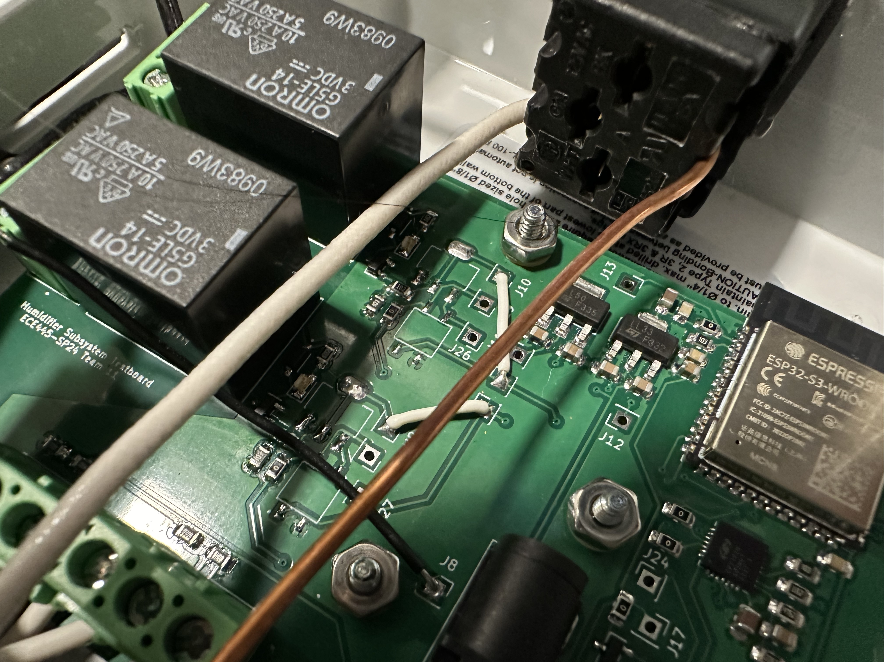
RV Table – Central Humidifier Subsystem (4)
Water level sensor contact water
Water-valve off when water detected
Notes:
jalen

Slide 23
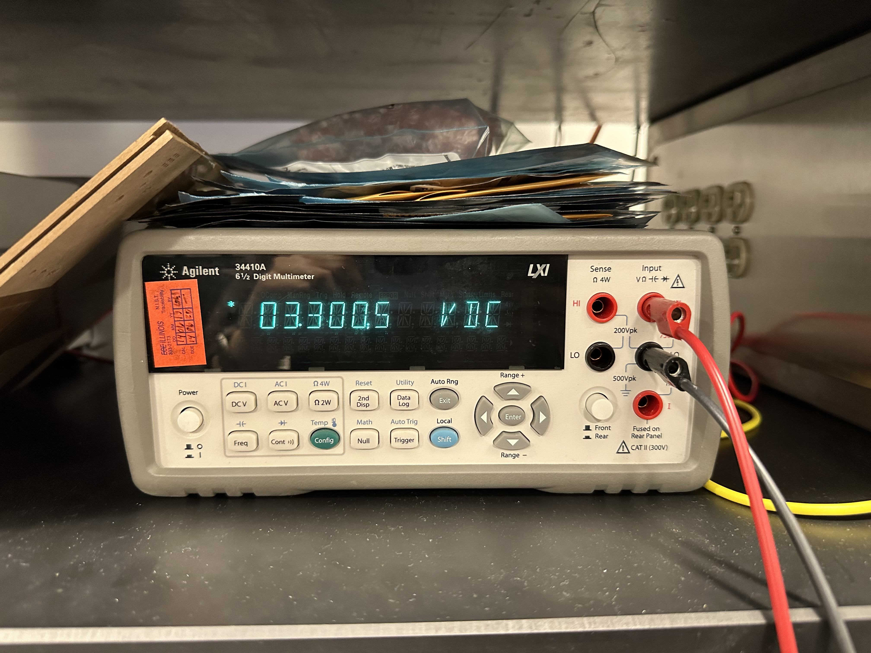
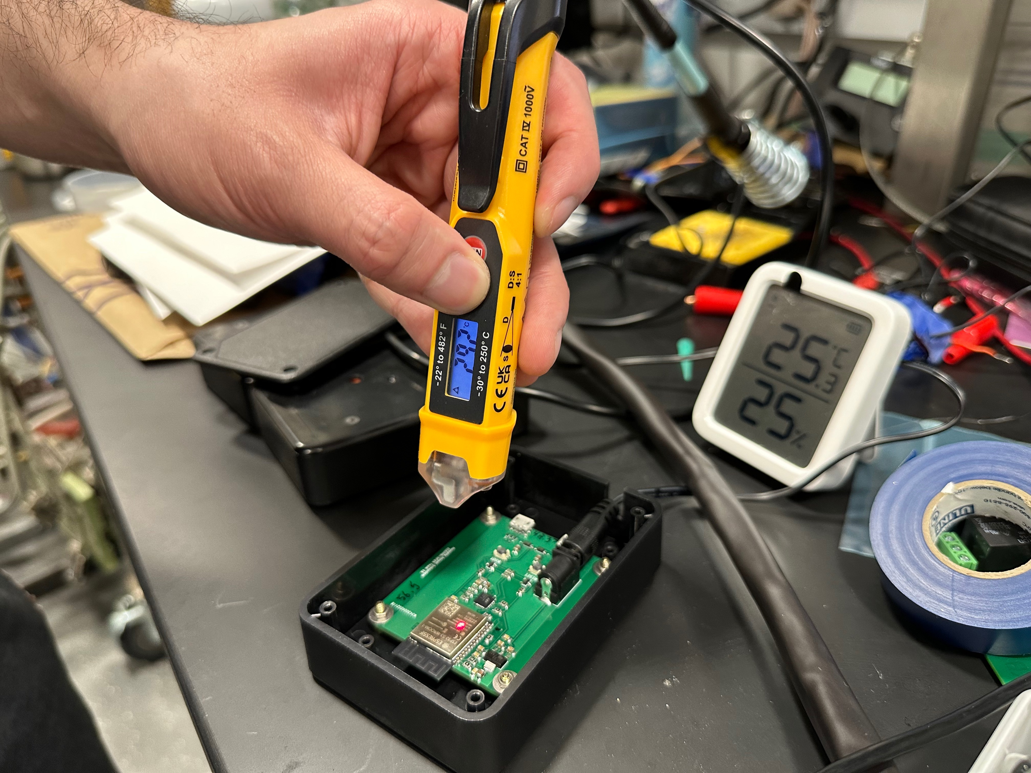
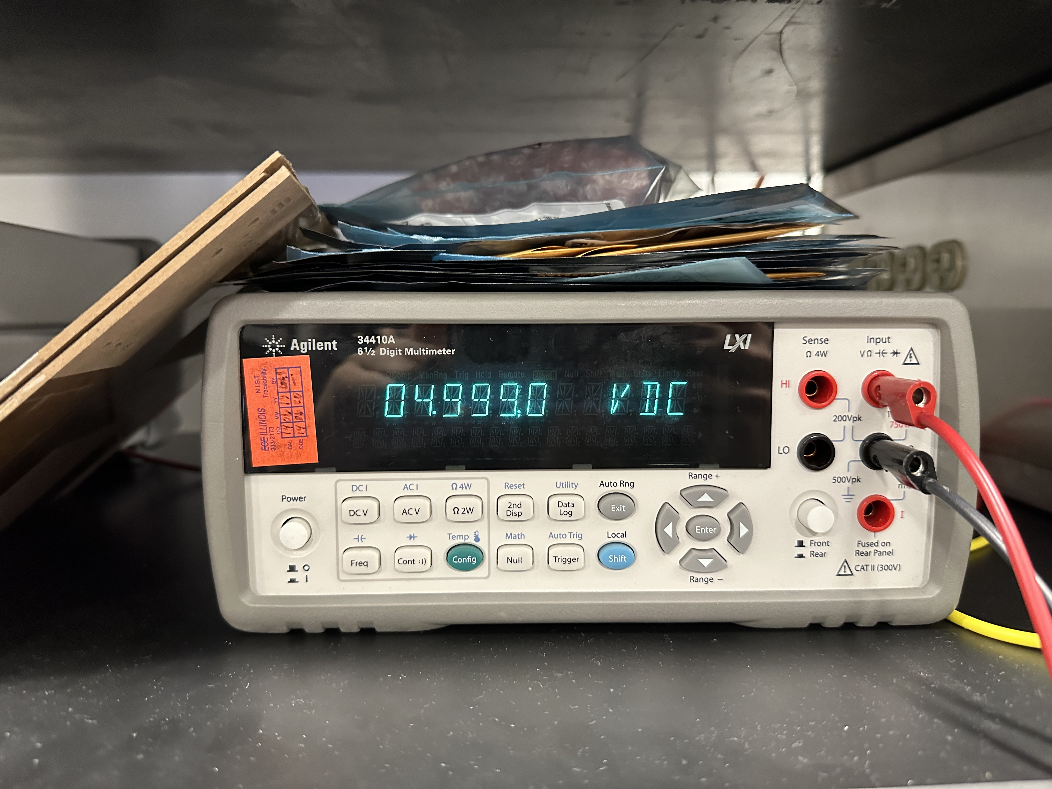
RV Table – Humidity Sensor Subsystem (1)
3.3V linear regulator output
Temperature reading with laser
5V linear regulator output
Notes:
woojin

Slide 24
RV Table – Humidity Sensor Subsystem (1)
Notes:
Woojin
Talk about voltage readings taken every minute for 1 hour
Very linear readings

Slide 25
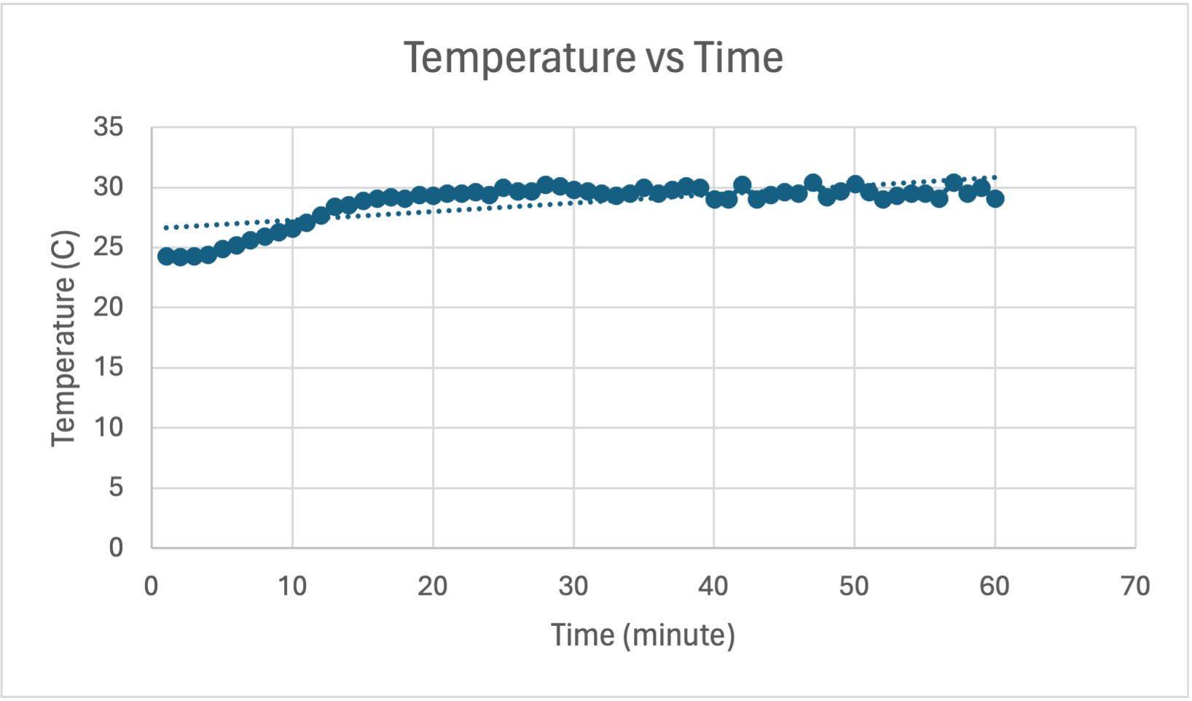
RV Table – Humidity Sensor Subsystem (1)
Notes:
Woojin
Talk about how it starts at room temperature, then stabilizes after "warm up"

Slide 26
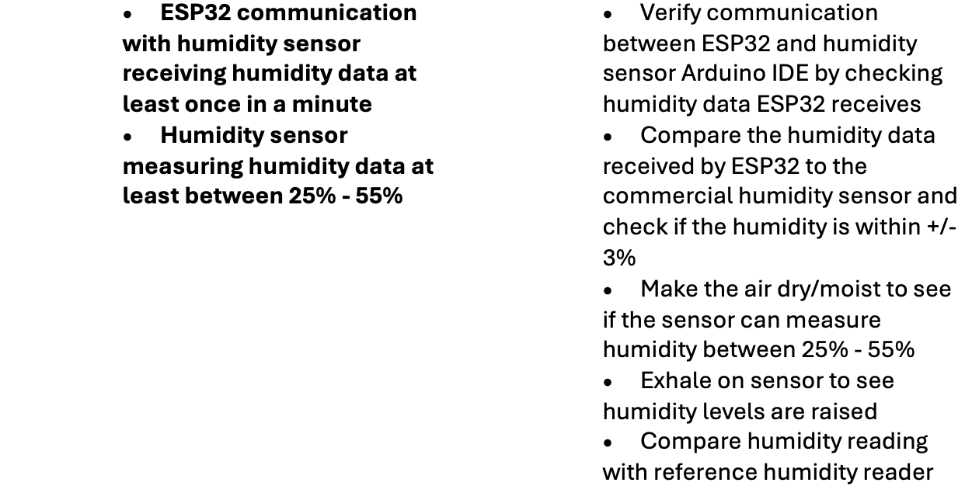
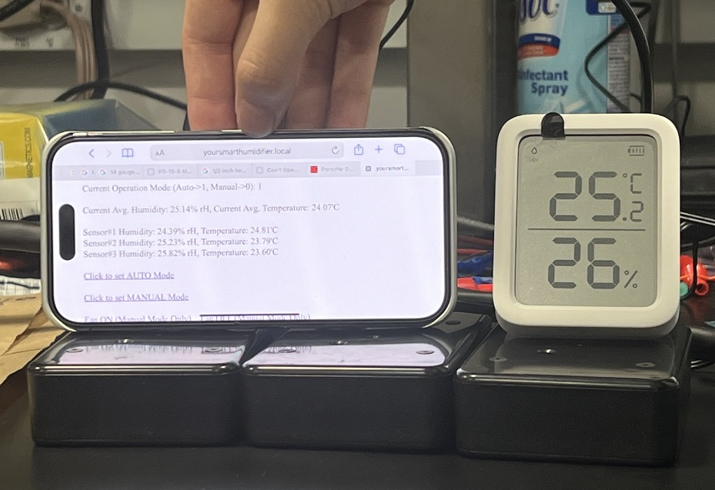
RV Table – Humidity Sensor Subsystem (2)
Commercial humidity and temperature sensor verification
Notes:
woojin

Slide 27
Project Achievements and Successes
Sensor Subsystem reads temperature and humidity data from SHT45
Sensor Subsystem communicates with Humidifier Subsystem with Wi-Fi
Humidifier Subsystem successfully activates humidifier
Humidifier Subsystem successfully reads from water level sensors
Humidifier Subsystem successfully activates water valve
Bonus:
User Interface through access point to control Humidifier Subsystem
Reliability tested for 4 weeks, running 24/7
Notes:
Andrew

Slide 28
Challenges
No failures on current design
Hardware
Initial 12V input to PCB was too high for Linear Voltage Regulator
Relay design
Isolation, creepage, clearance
Optocoupler
SHT45 location and isolation
Modular overall design
Software
Concurrent multi-node communication
Notes:
Andrew and woojin
Isolation, creepage, and clearance
Isoltaion: prevent current flowing where it shouldn’t
Ground pad not in area
Creepage and clearance
Spacing, and cutout
Optocoupler
Reduce noise
LED and photo detector
SHT45 is isolated at back of board
Modular design so any humidifier can use product
Woojin:

Slide 29
Conclusion and Future Plans
Integrate with Amazon Alexa, Apple HomeKit, and Google Assistant
Change linear voltage regulator to buck converter
Further compact PCB
Remove ESP32 programming components
Create original AC/DC Converter if budget allows
Improve PCB enclosure design
Improve UI design
Potentially remove water level sensor and water valve
Making product modular for all manual humidifiers
"Students learn the most then they struggle with challenges" - Minh Do
Notes:
Andrew

Slide 30
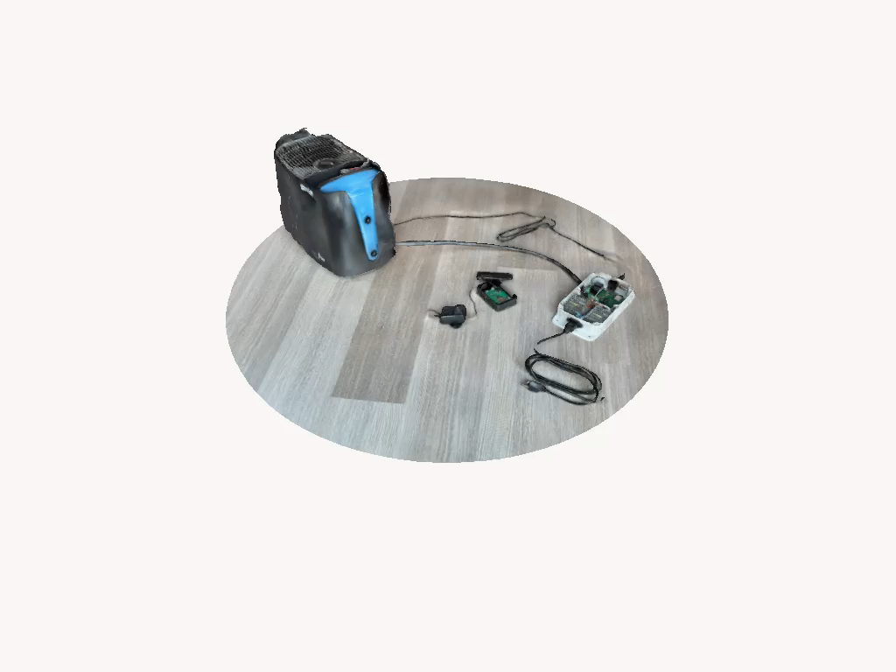
Your Oasis Awaits: Refresh, Rejuvenate, Breathe
Notes:
Everyone//end

Slide 31
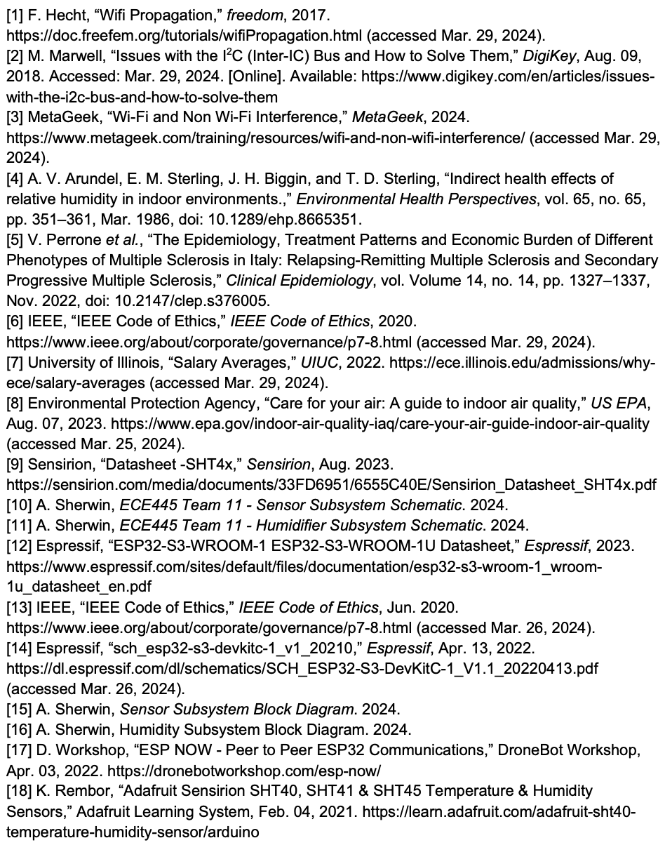
References

Slide 32
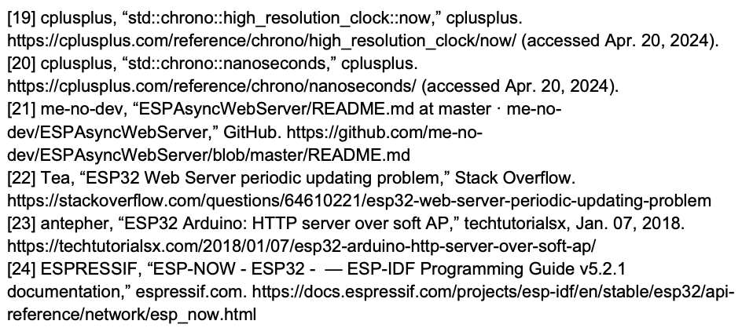
References (continued)

